Slide 1
Univariate Hypothesis Testing
SSI II
Jan 31, 2018

Slide 2
Univariate Hypothesis Testing

Slide 3
Essential Questions
How do we conduct hypothesis tests?
What does statistical significance (not) tell us?

Slide 4
Hypotheses
General definition
  A hypothesis is a specific statement about what we expect to observe in the real world if a theory is true
Statistical definition
  A statistical hypothesis is a claim about a population that can be tested by drawing a random sample

Slide 5
Null Hypotheses
For every hypothesis, there is a null hypothesis
If our hypothesis is wrong, then the null hypothesis should be true
Often labeled “H₀”(null hypothesis)

Slide 6
Alternative Hypotheses
The “real” hypothesis
Predicts an effect or a difference
Often labeled “H_{A}”

Slide 7
Null Hypotheses Example
Hypothesis: Better economic conditions lead to more votes for the incumbent
Null hypothesis: Better economic conditions do not lead to more votes for the incumbent
  OR There is no relationship between economic conditions and votes for the incumbent

Slide 8
What is the corresponding null hypothesis?
Median family income is higher in urban counties than in rural counties.
The more education a person has, the higher his or her income.
As the percentage of a country’s population that is literate increases, the country’s political process becomes more democratic.
The older people become, the more likely they are to be conservative
People who read the newspaper more are more informed about current events.

Slide 9
Hypothesis Tests
Was it due to chance, or something else?

Slide 10
Hypothesis Tests
A statistical hypothesis is a claim about an (unknown) population parameter
We use statistical inference techniques to determine whether the claim is likely to be true

Slide 11
Univariate Hypothesis Tests
Univariate = one variable
Question: Do a majority of Americans oppose building a wall with Mexico?
Null Hypothesis: 50% or more of Americans support the wall

Slide 12
Univariate Hypothesis Tests
For hypothesis tests about population means, we can apply the central limit theorem and calculate a 95% confidence interval (for sufficiently large samples)
Note: We never say that we “accept” a hypothesis!
Hypothesized Value | Conclusion
Outside the confidence interval | Reject the null hypothesis
Inside the confidence interval | Fail to reject the null hypothesis
Notes:
We talk about rejecting hypothesis, rather than “accept” the hypothesis

Slide 13
Example
In a Quinnipiac poll (N=1,004) taken Jan 25-28:
  41% are in favor of the wall
  55% oppose the wall
  4% are unsure
The margin of error is 3.7
Can we reject the null hypothesis?

Slide 14
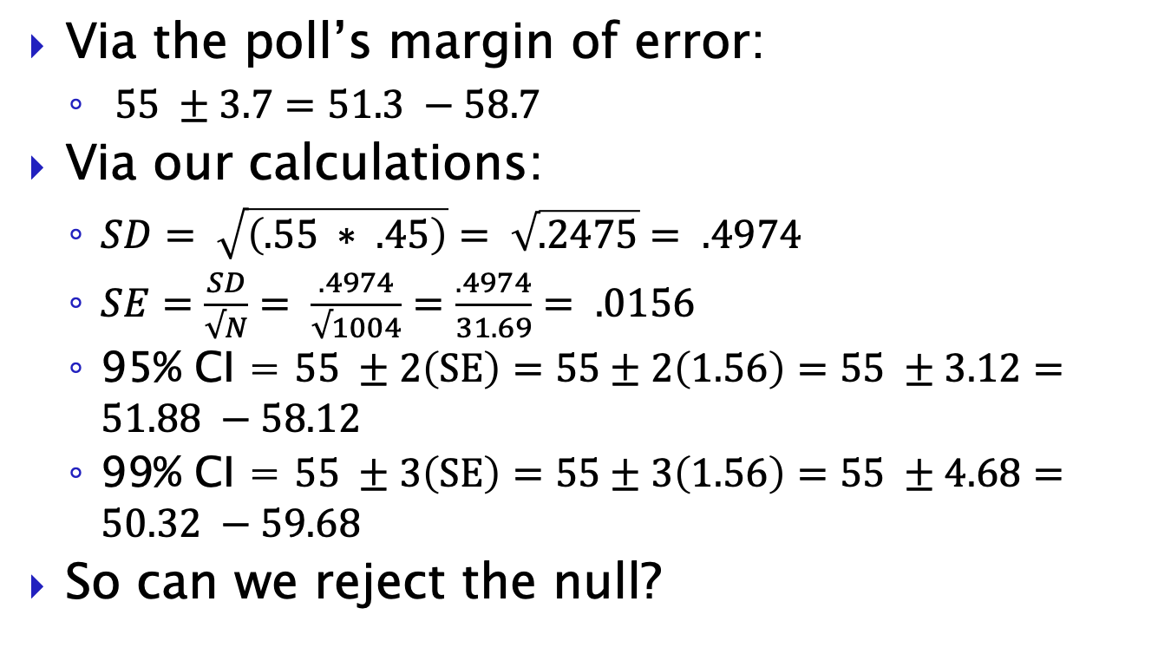
Example
Via the poll’s margin of error:
  $55 ±3.7=51.3 −58.7$
Via our calculations:
  $SD= \sqrt{\left(.55 ∗ .45\right)}= \sqrt{.2475}= .4974$
  $SE=\frac{SD}{√N}= \frac{.4974}{√1004}=\frac{.4974}{31.69}= .0156$
  95% CI = $55 ±2\left(SE\right)=55±2\left(1.56\right)=55 ±3.12=51.88 −58.12$
  99% CI = $55 ±3\left(SE\right)=55±3\left(1.56\right)=55 ±4.68=50.32 −59.68$
So can we reject the null?

Slide 15
Example
Hypothesis: A majority of Americans support raising the minimum wage to $15
Data: 54% support among a random sample of 1,125 adults nationwide
Notes:
Quinnipiac University Poll, July 27-Aug 1, 2017

Slide 16
Example
Hypothesis: More than 50% of Americans support raising the minimum wage to $15
Data: 54% support among a random sample of 1,125 adults nationwide
  Mean = 0.54 Std. dev = .498
  SE = .0149
  Confidence interval 0.54 ± .0298 ➔ 51% - 57%
Conclusion: At the 95% confidence level, we can reject the null hypothesis that 50% of Americans do not support raising the minimum wage to $15
Notes:
Current federal minimum wage is $7.25
Data from CBS News/NYT Poll, May 28-31, 2015

Slide 17
Different Levels of Confidence
Example: Support for raising the minimum wage
  Mean =.54 Std dev=.498 SE=.0149
68% confidence interval .54 ±.0149
  52.58% to 55.49%
95% confidence interval .54 ± 2*. 0149
  51.02% to 56.98%
99% confidence interval .54 ± 3*. 0149
  49.53% to 58.47%

Slide 18
Classical Hypothesis Testing
Before you have any data:
  Set up a null hypothesis and an alternative hypothesis
    Null hypothesis – no relationship
    Alternative hypothesis – relationship (positive, negative, or either)
  Choose a significance level (p-value) and find the corresponding critical value of the test statistic for which the null hypothesis would be rejected
    Significance level (error level) = 100% - confidence level
    5% significance = 95% confidence

Slide 19
Critical Value
A predetermined standard for a statistical test such that if the calculated value is:
  Greater than the critical value, we conclude that there is a relationship between the two variables
  Less than the critical value, we cannot make such a conclusion

Slide 20
Classical Hypothesis Testing
Once you have the data:
  Calculate the test statistic for the null hypothesis using sample data
  Compare the test statistic to the relevant critical value
    Test statistic > critical value -> Reject null hypothesis
    Test statistic ≤ critical value -> Fail to reject null hypothesis
  Draw a conclusion
    Reject null hypothesis -> Tentatively accept alternative hypothesis
    Fail to reject null hypothesis -> No support for alternative hypothesis

Slide 21

Test Statistic

Slide 22
z-tests
Tests using the z-statistic
The z-statistic says how many standard errors an observed value is away from an expected value
The null hypothesis gives you the expected value

Slide 23
z-tests
We can use the normal curve to get the probability of a certain z-score

Slide 24
t-tests
If you have a small sample, you use a t-test instead of a z-test
t-tests use a different curve (not the normal curve) to figure out the probability
  (student’s) t-distribution
The exact shape of the t-distribution depends on your sample size, or technically on the degrees of freedom

Slide 25
Degrees of Freedom for t-test
Degrees of freedom = N-1

Slide 26
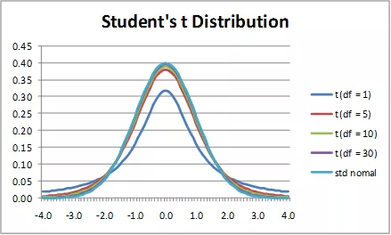
t-Distribution

Slide 27
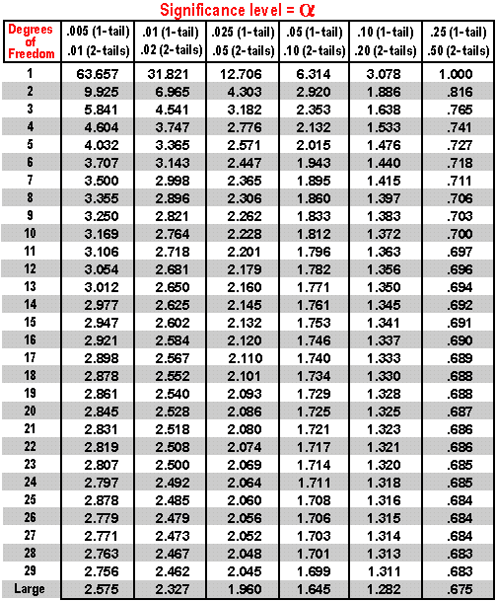

Slide 28
P-Values
p = probability of observing the test statistic if the null hypothesis were true
Calculate test statistic
Use appropriate table for probability distribution of the test statistic
Look up p-value (taking note of the direction and whether the test is one or two sided) and compare to the critical value (significance level)

Slide 29
The Logic of p-values and Significance
We compare the observed relationship between X and Y in sample data with what we would expect to find if X and Y were not related in the underlying population
The p-value is the probability that we would see the relationship that we are finding because of random chance
p-values range from 0 to 1
Usually p<0.05 in order to reject H₀

Slide 30
Statistical Significance
If the p-value is low so that it is implausible that the observed data were generated from the null hypothesis, we can say that the test statistic is statistically distinguishable from the hypothesized value at the level of the p-value
For example: “The difference between the sample mean and hypothesized mean is statistically significant at the 5% (significance) level”

Slide 31
Confidence Levels, α, and p-values
Confidence Level | p-value should be less than α
90% | α=0.10
95% | α=0.05
99% | α=0.01
99.9% | α=0.001

Slide 32
Example
"Which one of the following was the best single sports accomplishment of 2016?
  The Chicago Cubs winning their first World Series since 1908.
  U.S. Women's Gymnastics winning consecutive Olympic team gold medals.
  The Cleveland Cavaliers winning the NBA title for the city's first major championship since 1964.
  The Denver Broncos winning the Super Bowl in Peyton Manning's final NFL game.
  Leicester City winning the Premier League for the first time in history despite 5,000 to 1 odds against them."

Slide 33
Example
Chicago Cubs - 56%
Women’s Gymnastics – 20%
Cleveland Cavaliers – 8%
Denver Broncos – 7%
Leicester City – 5%
Unsure – 4%
N=585 adults nationwide who consider themselves sports fans

Slide 34
Example
H₀: 50% or less of American sports fans think the Cubs’ victory was the biggest sports accomplishment of 2016.
H_{A}: A majority of American sports fans think the Cubs’ victory was the biggest sports accomplishment of 2016.

Slide 35
Example
Z=(observed-expected)/standard error
Z=(.56-.50)/.02
Z=.06/.02
Z=3

Slide 36
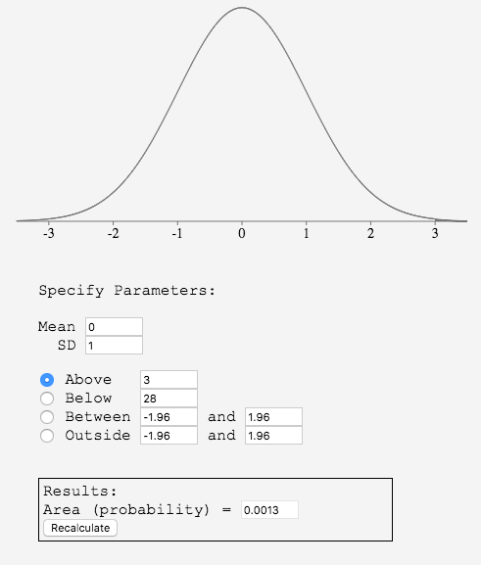

Slide 37
Example
P-value = .0013
The probability that we got a sample mean of 56% if the true population mean is 50% is only .0013.
We can be 99.87% confident that a majority of American sports fans think the Cubs’ victory was the biggest sports accomplishment of 2016.

Slide 38
Connecting Concepts
How does this connect to confidence intervals?

Slide 39
Z-score Clarification
Previously, we said:
Today, we said:
  Z=(observed-expected)/standard error
The first is for a data distribution
The second is for a (theoretical) sampling distribution
Z = (X-μ)/σ

Slide 40
Essential Questions
How do we conduct hypothesis tests?
What does statistical significance (not) tell us?

Slide 41
Next time…
Bivariate (two variable) tests

